Slide 1
Pick Your Plate
By: ^{The}A-Team
p.s. Jim V, David B, Andrea F, and Jonathan P

Slide 2
Goal
To find recipes to cook at home or restaurants to eat out.

Slide 3











<technologies/>

Slide 4
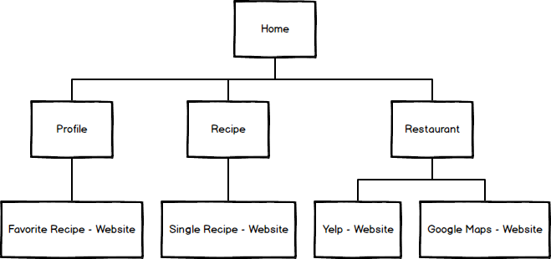
Site Map

Slide 5
DEMO TIME!!!

Slide 6
Question?

